Slide 1
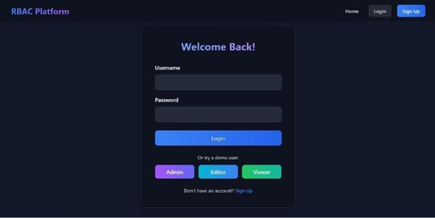
🧠 Full Stack RBAC Platform
Role-Based Access Control Web Application using MERN Stack
  MongoDB, Express, React, Node.js
  JWT Authentication, Authorization, CRUD, Audit Logging
  Responsive UI with TailwindCSS
  Secure, modern user management system
23BIS70134-DIPALI RAWAT
23BIS70123-ANISH KUMAR

Slide 2
🎯 Project Objective
Implement secure Role-Based Access Control (RBAC)
Enable authentication and role-based privileges
Maintain audit logs for critical user actions
Demonstrate modular MERN architecture
Deliver intuitive, responsive interface

Slide 3
❗ Problem Statement
Many apps lack fine-grained permission control
Unauthorized access and security risks
No audit trail for user activities
Complex user privilege management
Solution: RBAC system with Admin, Editor, and Viewer roles ensuring safe, structured access

Slide 4
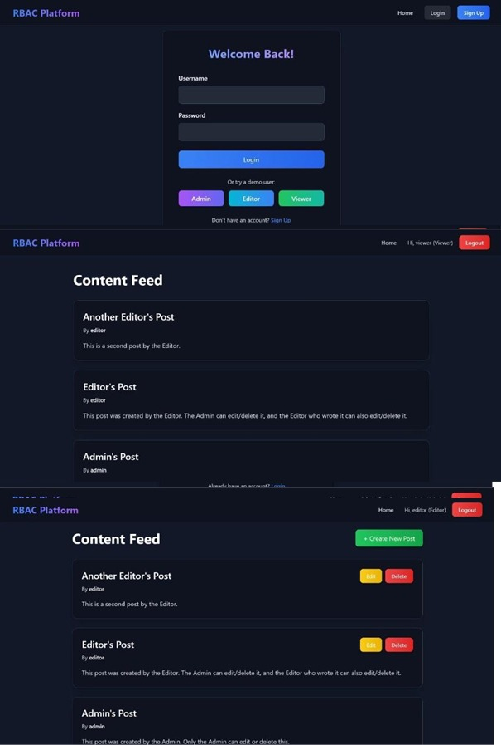
🚀 Key Features
🔐 JWT Authentication & Refresh Tokens
👥 Role Management and Authorization
📝 CRUD Operations on Posts
📜 Audit Logging for transparency
⚙️ Rate Limiting & Validation
🎨 Responsive TailwindCSS UI

Slide 5
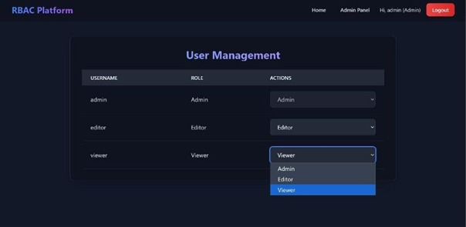
👥 User Roles & Permissions
Admin → Manage all users, posts, and logs
Editor → Create, update, delete own posts
Viewer → Read-only access
Middleware checks role permissions before API execution

Slide 6
🧠 System Architecture
Frontend: React + Axios
Backend: Node.js + Express
Database: MongoDB (Mongoose)
Authentication: JWT
Deployment: Vercel (Frontend), Render (Backend), Mongo Atlas
Flow: React → Express API → MongoDB

Slide 7
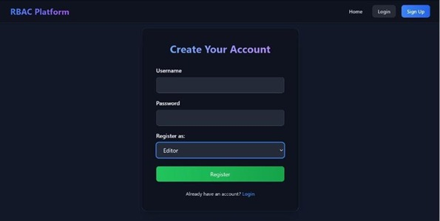
🔒 Authentication Flow
1. User logs in → credentials verified with bcrypt
2. Access + Refresh tokens issued
3. Middleware validates access on each route
4. Axios auto-refreshes tokens when expired
5. Unauthorized users redirected safely

Slide 8
🧩 API & Backend Modules
Modules:
  - /auth → register, login, refresh, logout
  - /content → CRUD posts
  - /users → Manage roles
  - /audit-logs → Track actions
Includes Morgan logging & express-validator

Slide 9
🌱 Database Design & Seeding
Collections:
  - User: username, password, role
  - Content: title, body, createdBy
  - AuditLog: user, action, timestamp
Seed Users:
  - admin (Admin)
  - editor (Editor)
  - viewer (Viewer)

Slide 10
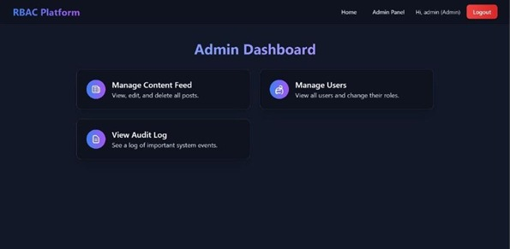
🎨 Frontend Interface
Built with React + TailwindCSS
React Router v6 for navigation
Protected routes per role
Axios hooks for API calls
Components: Navbar, Dashboard, RoleManager
Modern dark theme with glassmorphism design

Slide 11
🧰 Security & Deployment
bcrypt password hashing
express-rate-limit for login protection
HttpOnly secure cookies
express-validator for form data
Audit logs track actions
Deployed via Vercel (Frontend), Render (Backend)

Slide 12
🧾 Results & Future Scope
Achievements:
  - Secure, role-based web app using MERN
  - Modular backend & responsive frontend
  - Live audit tracking
Future Enhancements:
  - Email verification & analytics
  - Cloud integration & Docker deployment

Slide 13
Thankyou

